Slide 1
PRICE PREDICTION FOR USED CAR USING RANDOM FOREST ALGORITHM
TEAM MEMBERS
KAlALI MADHUSUDHAN GOUD(20N31A0597)
M SHIVAPRIYA REDDY(20N31A05B9)
KASALA SHREYA REDDY(20N31A05A7)
UNDER THE GUIDANCE OF
Mrs.p. honey diana

Slide 2
ABSTRACT
A car price prediction has been a high interest research area, as it requires noticeable effort and knowledge of the field expert. Considerable number of distinct attributes are examined for the reliable and accurate prediction.
To build a model for predicting the price of used cars the applied three machine learning techniques are Random forest regression and linear regression.
Respective performances of different algorithms were then compared to find one that best suits the available data set. The final prediction model was integrated into Java application. Furthermore, the model was evaluated using test data and the accuracy of 82% was obtained.
Key Words: Linear Regression, Used car Prediction, Random forest Regressor, Decision Tree Regressor

Slide 3
INTRODUCTION
Vehicle price prediction especially when the vehicle is used and not coming direct from the factory, is both a critical and important task. With increase in demand for used cars more and more vehicle buyers are finding alternatives of buying new cars.
There is a need of accurate price prediction mechanism for the used cars. Prediction techniques of machine learning can be helpful in this regard.
It is common to lease a car in many countries rather then buying a new car.
Car price prediction is anyhow interesting and popular problem. Accurate car price prediction involves expert knowledge, because price usually depends on many unique features and factors. Generally, most important ones are brand name and model, years, KMs driven and mileage.

Slide 4
PROPOSED AND EXISTING SYSTEM
EXISTING SYSTEM
The existing system includes a basic car price prediction using the inputted data and displays its output on simple static website and there is no use of different kinds of regression algorithms. There is only use of simple linear regression algorithm in the project. The existing gives less accuracy in result.
PROPOSED SYSTEM
In the proposed System, we have tried to solve the issues in existing system. We have developed a GUI. Also we have used three machine learning algorithms which are linear and random regression respectively in our system to predict the output more correctly with higher accuracy.

Slide 5
SOFTWARE AND HARDWARE REQUIREMENTS
Software:
Operating System: Windows 5 or above
Language: Python
Tools : Jupyter notebook , pycharm
Hardware:
Minimum: 2GB RAM and 20GB (64-bit) Hard Disk Space
1GHz Single Core CPU
Processor: Intel i3 or i5

Slide 6
SCOPE OF THE PROJECT:
A dataset, as the name suggests, is a collection of data. In Machine Learning projects, we always need a dataset. Firstly, we need the training dataset to train our model, to help it predict. Then, we use testing datasets to predict and check how accurate is our model.
In this project, I have used the dataset available on Kaggle. One can find various such sites to download from. (Note that the larger the dataset, the more time the model will take to train. As a beginner-friendly suggestion, T will tell you to take a medium-sized dataset with not too many values, to first understand its working)

Slide 7
LITERATURE SURVEY
Predicting the price of Used Car Using Machine Learning Techniques . The application of supervised machine learning techniques to predict the price of used cars .
The predictions are based on historical data collected from daily newspapers. Different techniques like multiple linear regression analysis, Random forest regression, k-nearest neighbours, naïve bayes and decision trees have been used to make the predictions.
Prediction Using Machine learning is Considerable number of distinct attributes are examined for the reliable and accurate prediction. To build a model for predicting the price of used cars.
They have applied three machine learning techniques (Artificial Neural Network, Support Vector Machine and Random Forest).
Price Evaluation model in second hand car system based on BP neural networks. In this the price evaluation model based on big data analysis is proposed, which takes advantage of widely circulated vehicle data and a large number of vehicle transaction data to analyze the price data for each type of vehicles by using the optimized BP neural network algorithm. It aims to establish a second-hand car price evaluation model to get the price that best matches the car.

Slide 8
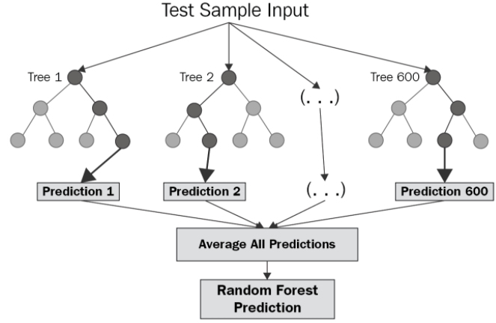
DOMAIN ANALYSIS
RANDOM FOREST REGRESSION
A Random Forest is an ensemble technique capable of performing both regression and classification tasks with the use of multiple decision trees and a technique called Bootstrap and Aggregation, commonly known as bagging.
FLOWCHART FOR DEPECTING RANDOM FOREST ALGORITHM

Slide 9
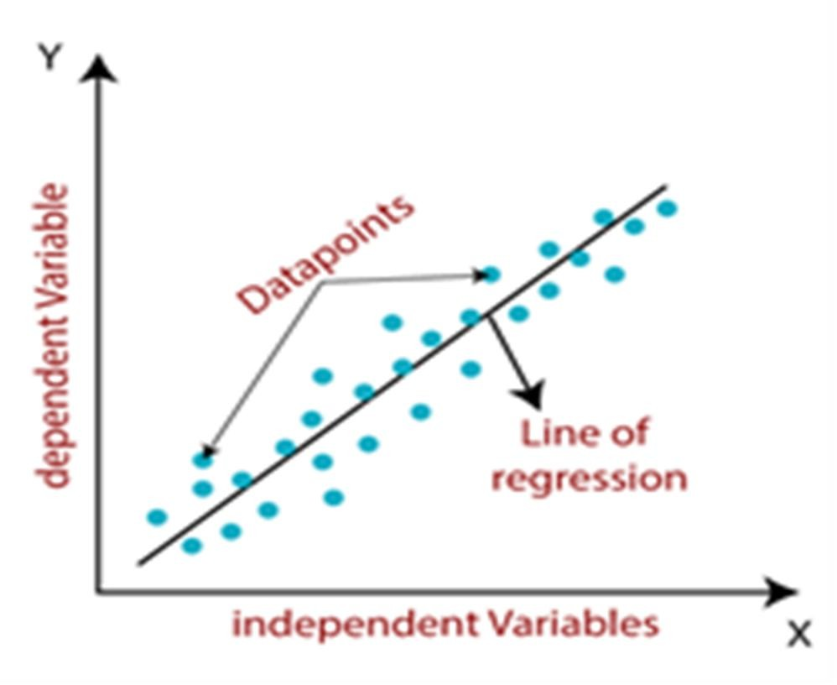
LINEAR REGRESSION
Linear regression is one of the easiest and most popular Machine Learning algorithms. It is a statistical method that is used for predictive analysis. Linear regression makes predictions for continuous/real or numeric variables such as sales, salary, age, product price, etc.
Linear regression algorithm shows a linear relationship between a dependent (y) and one or more independent (y) variables, hence called as linear regression. Since linear regression shows the linear relationship, which means it finds how the value of the dependent variable is changing according to the value of the independent variable.

Slide 10
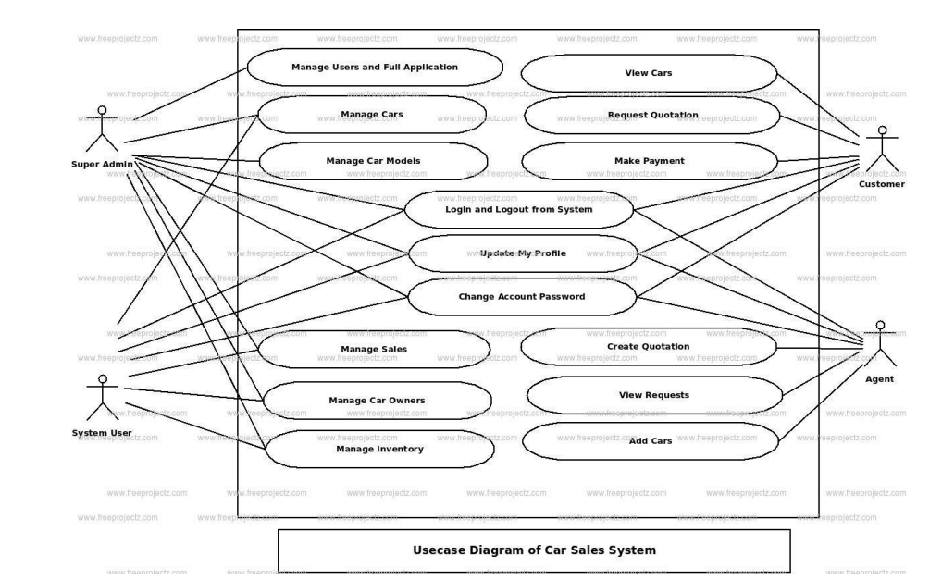
Use case diagram:

Slide 11
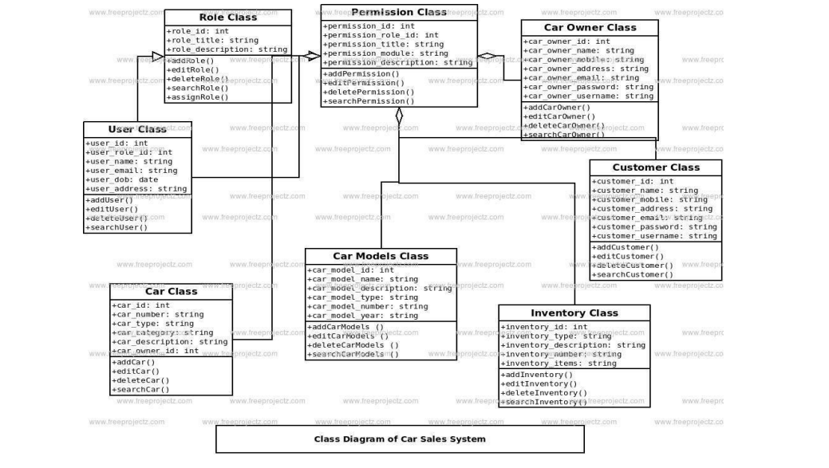
Class Diagram:

Slide 12
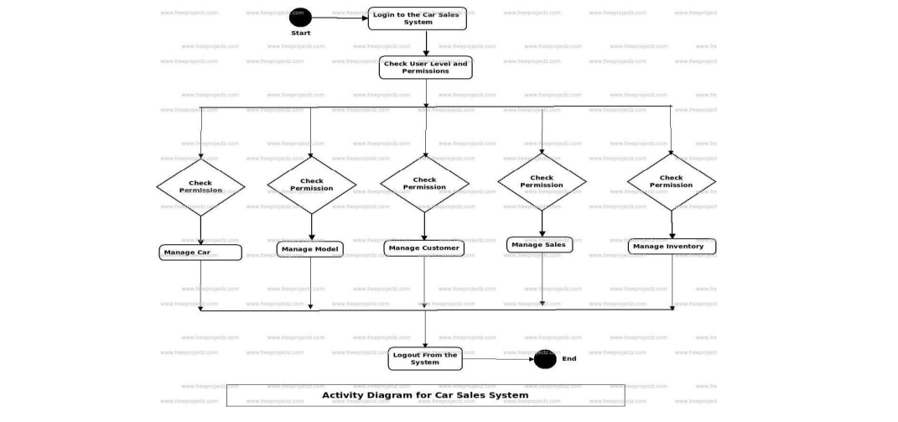
Activity Diagram:

Slide 13
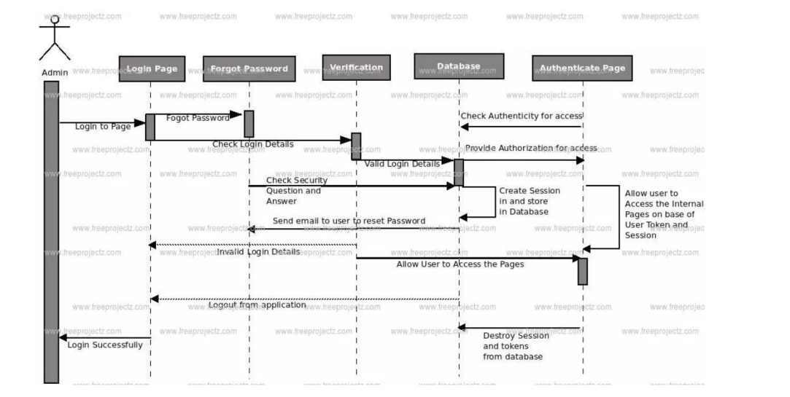
Sequence Diagram:

Slide 14
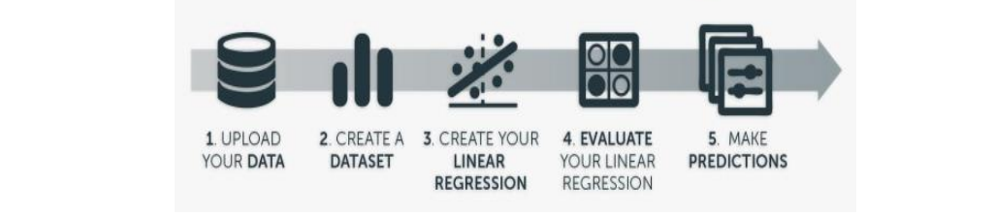
Architecture:

Slide 15
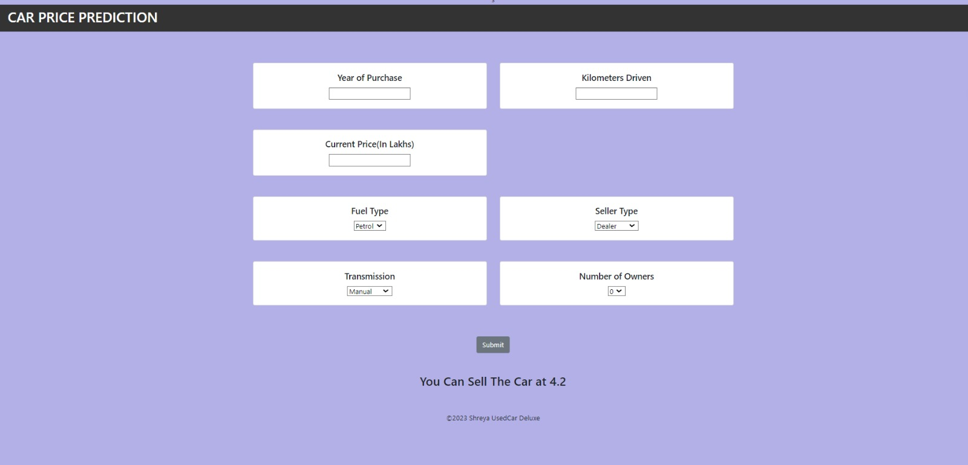
OUTPUT SCREENS :

Slide 16
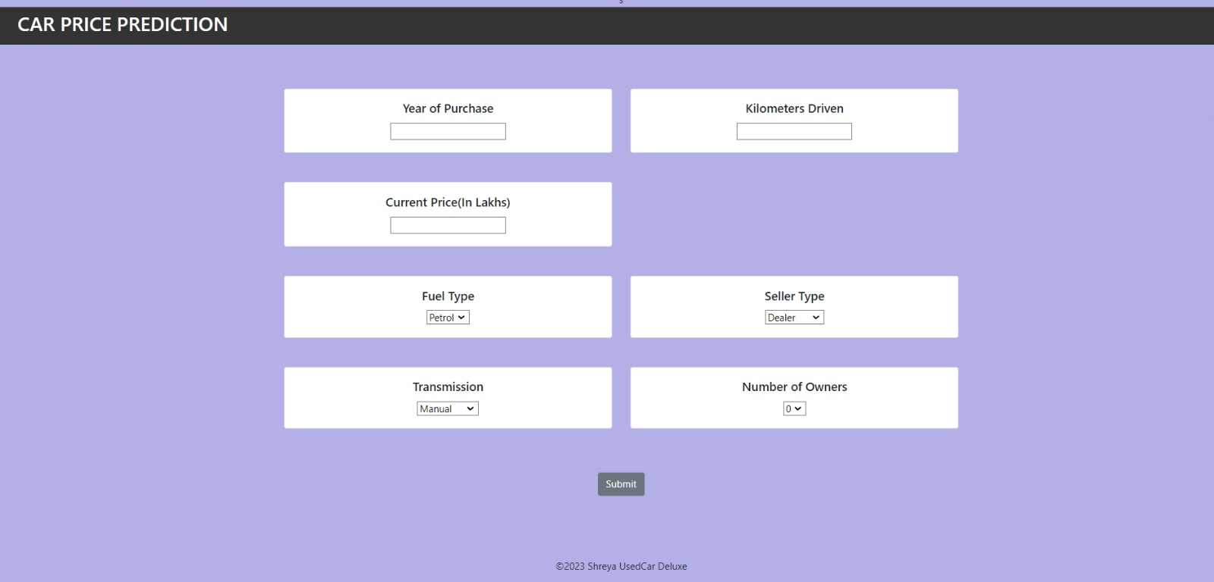

Slide 17
CONCLUSION:
This Project is aimed to develop a model to predict the prices of used cars. The results of the model helps to determine the important factors while predicting the prices of the used cars. Using the dataset available, a random forest model is developed that achieved an accuracy score on testing dataset of around 0.91. The model does suffer from overfitting . The importance of the features are determined using feature extraction done by random forest regressor and linear regressor. Some of the important features that does help in deciding the prices are Year , Engine Size.

Slide 18
THANK YOU

